Slide 1

Orientation to Computing-I
L T P :2 0 0
www.lpu.in Lovely Professional University

Slide 2

Unit-6 (Version Control)
Overview of Git and Github
Install git and Create a GitHub account
Create a local git repository
Add a new file to the repository
Creating a commit
Creation of a new branch
Git Commands
www.lpu.in Lovely Professional University

Slide 3

What is Git and GitHub?
Git: Git is a distributed version control system for tracking changes in source code during software development. It is designed for coordinating work among programmers, but it can be used to track changes in any set of files. Its goals include speed, data integrity, and support for distributed, non-linear workflows.
GitHub: GitHub is a web-based Git repository hosting service, which offers all of the distributed revision control and source code management (SCM) functionality of Git as well as adding its own features.
www.lpu.in Lovely Professional University

Slide 4
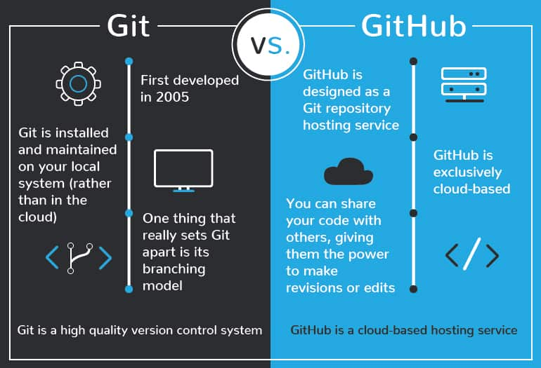
Diff. between Git and GitHub?
www.lpu.in Lovely Professional University

Slide 5
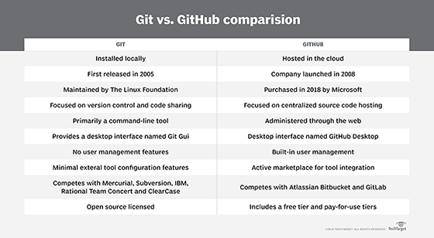
Diff. between Git and GitHub?
www.lpu.in Lovely Professional University

Slide 6
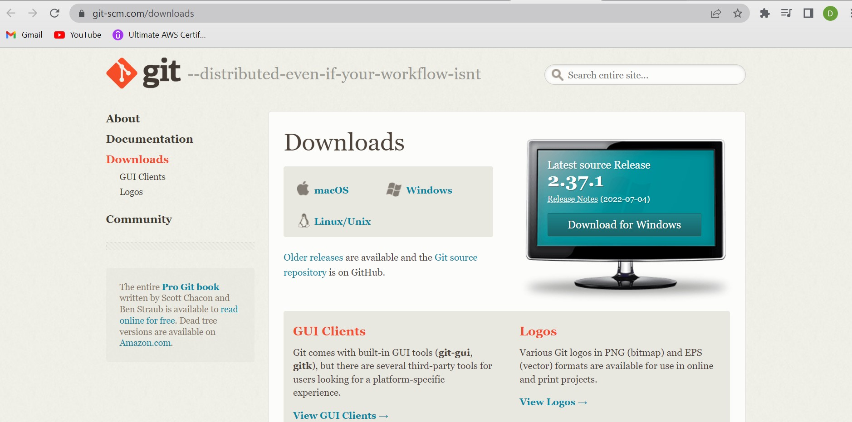
Install Git
https://git-scm.com/downloads
www.lpu.in Lovely Professional University

Slide 7
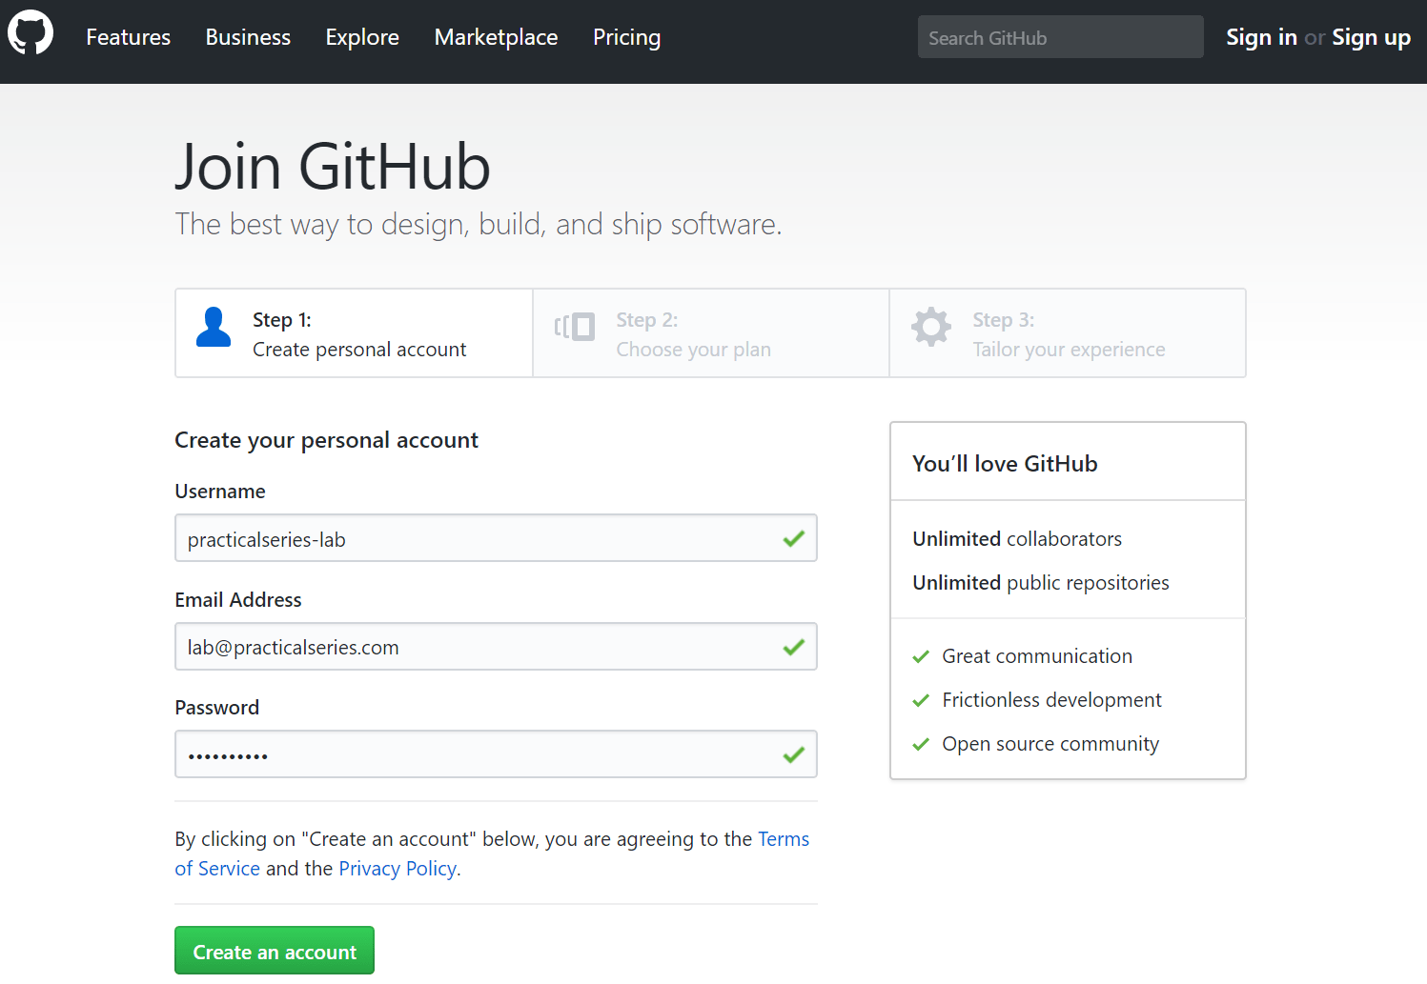
Create GitHub Account
https://github.com/
www.lpu.in Lovely Professional University

Slide 8
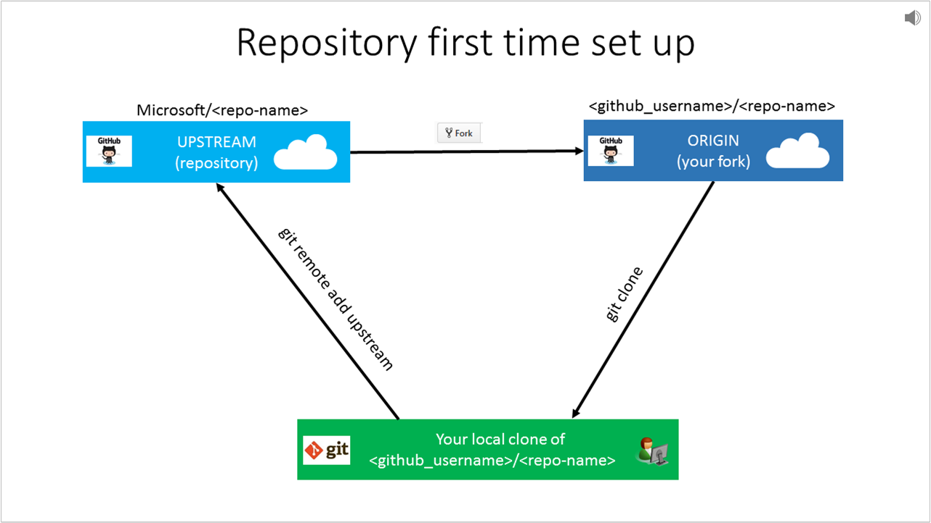
Create a local git repository
Start a new git repository
Create a directory to contain the project.
Go into the new directory.
Type git init .
Write some code.
Type git add to add the files (see the typical use page).
Type git commit .
www.lpu.in Lovely Professional University
Notes:
https://kbroman.org/github_tutorial/pages/init.html

Slide 9
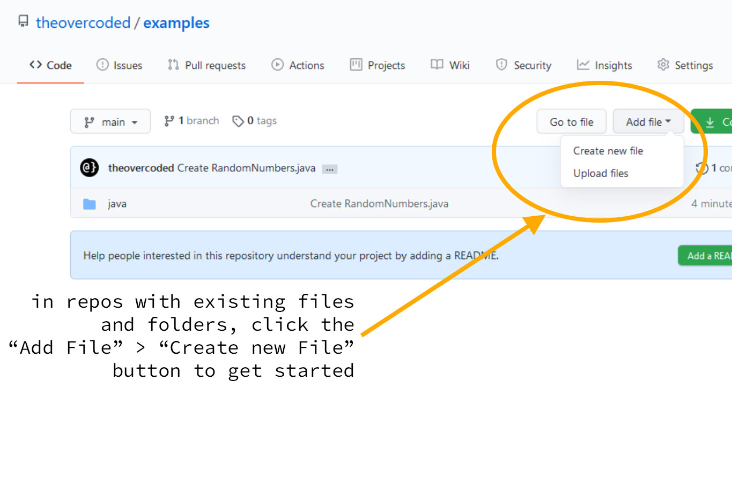
Add a new file to the repository
Create your new files or edit existing files in your local project directory.
Enter git add --all at the command line prompt in your local project directory to add the files or changes to the repository.
Enter git status to see the changes to be committed.
www.lpu.in Lovely Professional University

Slide 10
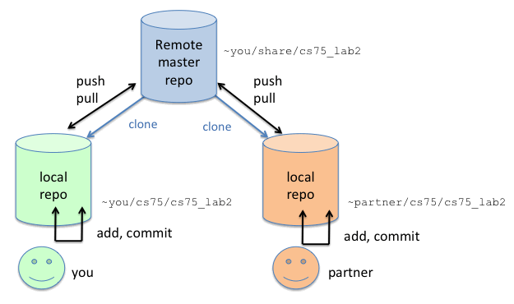
Creating a Commit
www.lpu.in Lovely Professional University

Slide 11
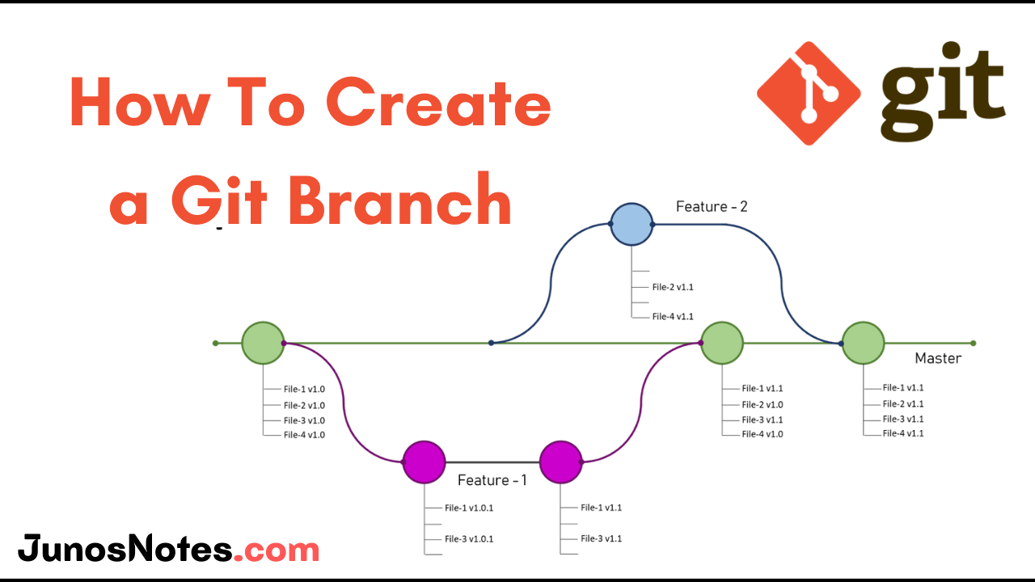
Creation of a new branch
The git branch command can be used to create a new branch. When you want to start a new feature, you create a new branch off main using git branch new_branch . Once created you can then use git checkout new_branch to switch to that branch.
www.lpu.in Lovely Professional University

Slide 12






Git Commands
Learn the concept of controlling, forking, building repositories

Slide 13





Git Commands
Introduce yourself to Git
$ git config --global user.name {given name}
$ git config --global user.email {given email}

Slide 14
Git Commands
Run your code editor
$ code.

Slide 15
Git Commands
Intialize empty Git repository
$ git init

Slide 16
Git Commands
Adding the work to staging area
$ git add {filename}

Slide 17
Git Commands
Commiting from stage to final
$ git commit

Slide 18
Git Commands
add new file to repository
$ touch {file name}

Slide 19
Git Commands
If you want all files to be added to staging area
$ git add -A

Slide 20
Git Commands
Adding comments while inserting commits
$ git commit -m "your comment"

Slide 21
Git Commands
Undo the work done by mistake in staging area from a file
$ git checkout {filename}

Slide 22
Git Commands
Recovery for multiple files altogether
$ git checkout -f

Slide 23
Git Commands
Check for complete logs
$ git log
Check for complete logs but with numbered steps
$ git log -p -{mention no of steps}

Slide 24
Git Commands
To check for changes in file
$ git diff

Slide 25
Git Commands
Auto commit all files in staging area
$ git commit -a -m "Comment"

Slide 26
Git Commands
Removing files
$ git rm {filename}

Slide 27
Git Commands
Branching into repository
$ git branch {branch name}
Switching to new branch
$ git checkout {branchname}

